Slide 1
At-Show Branding
Escalators, Banners and Clings

Slide 2
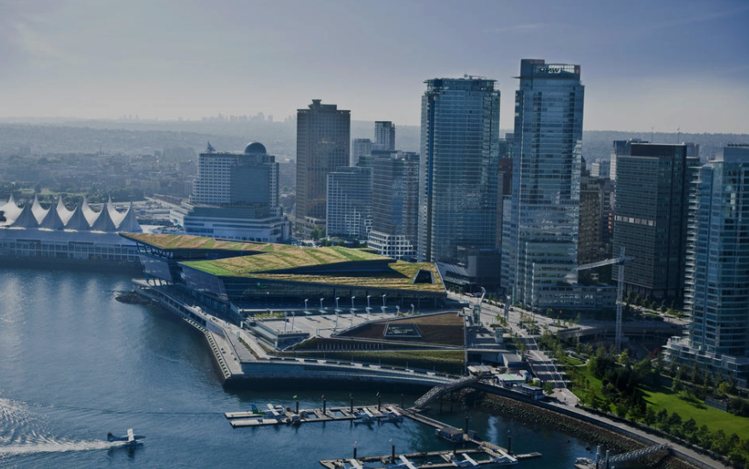
Overview West Hall Layout

Slide 3
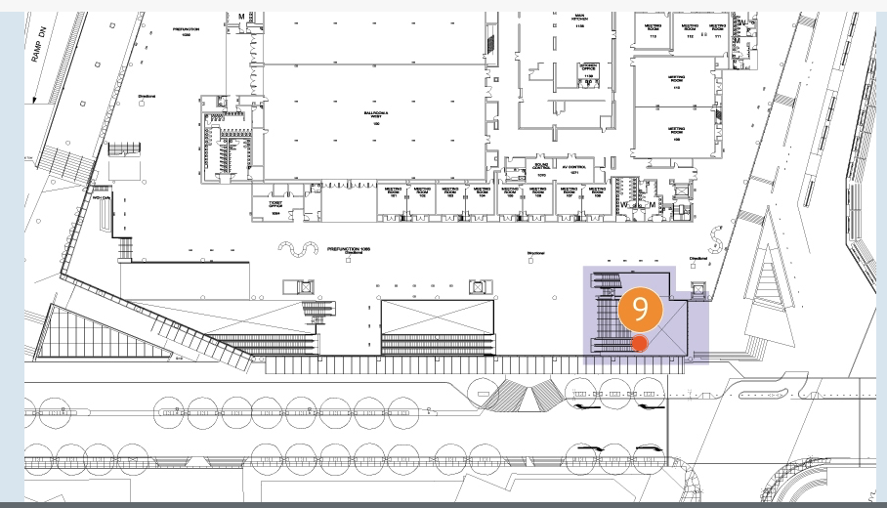
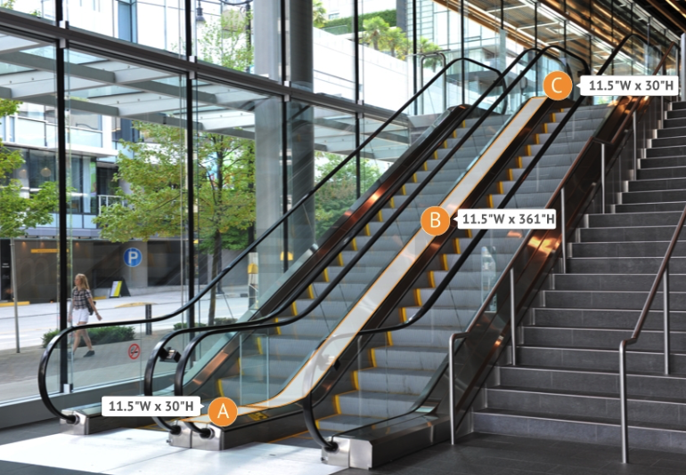
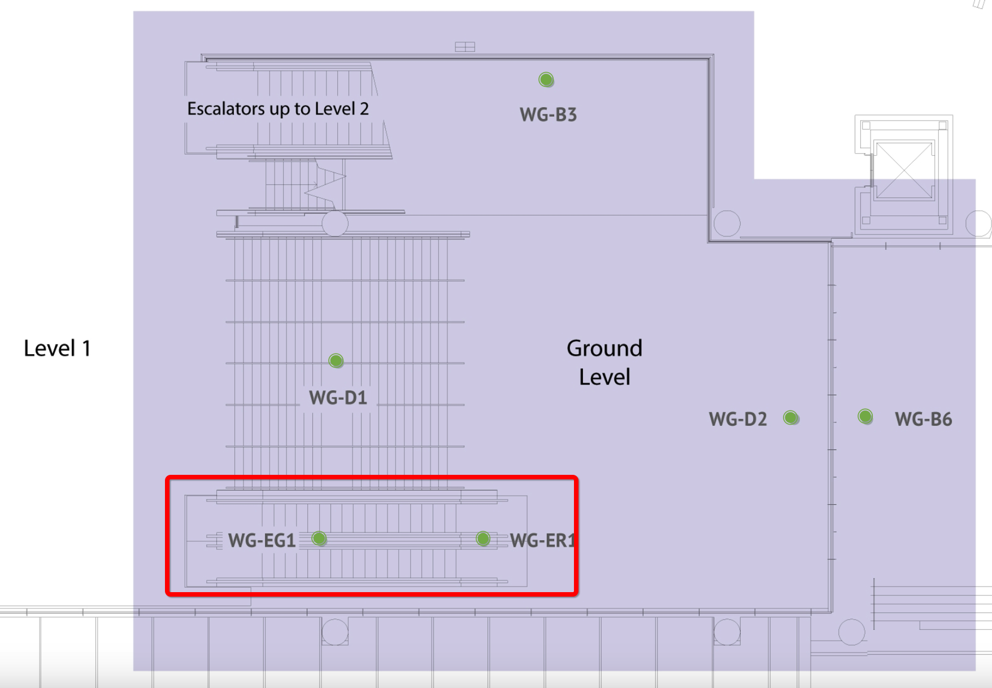
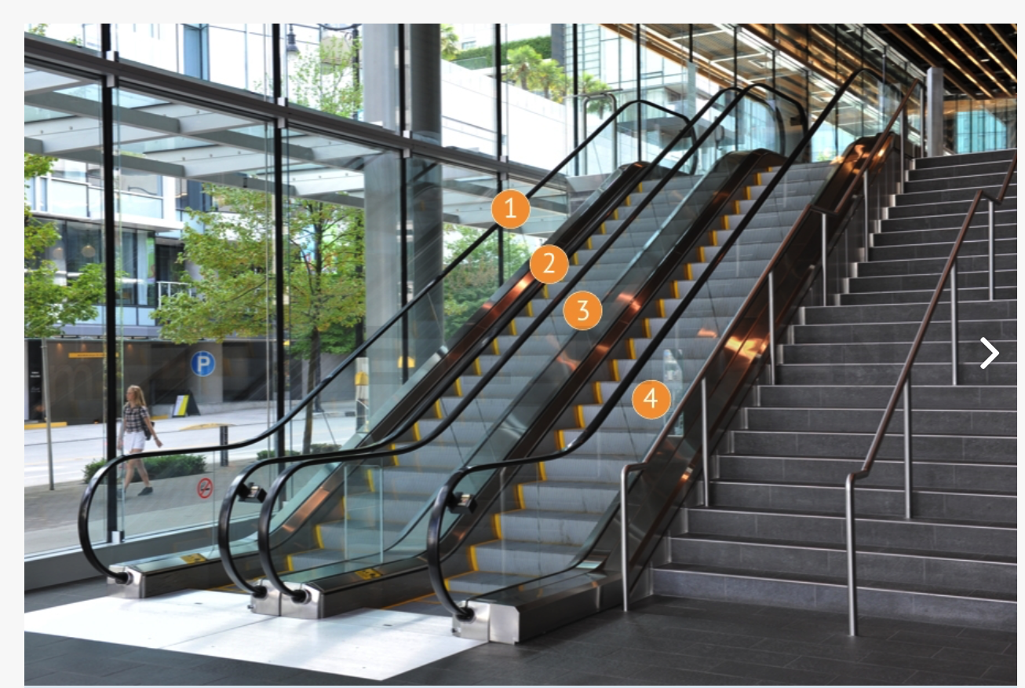
Escalator Runner and Clings WG-ER1 – WG-EG1 Ground Level $13,500
Exclusive
Opportunity

Slide 4
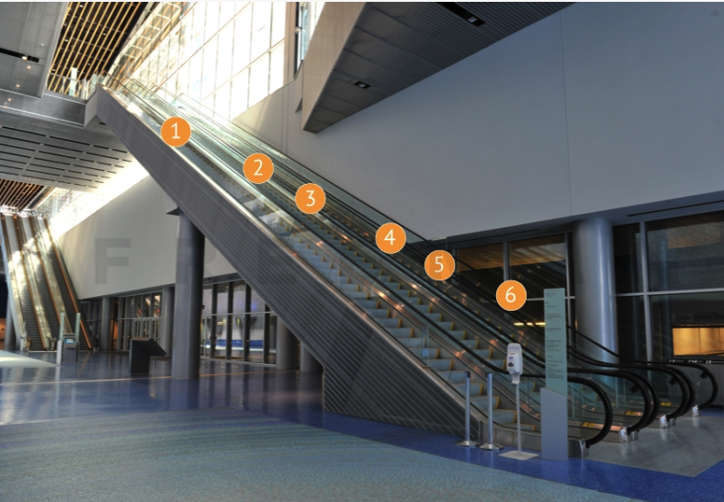
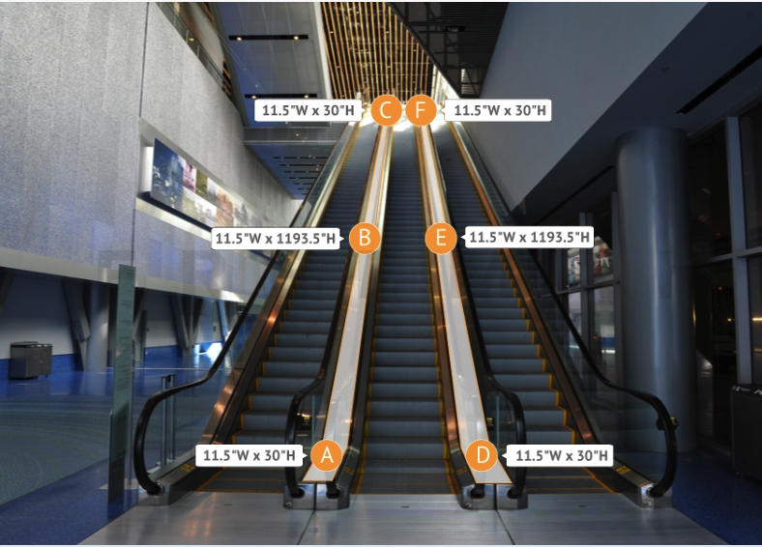
Escalator Runners and Clings WE-ER11 and WE-EG12 Exhibit Level Near A Entrance, Burrard Side $40,000
Exclusive
Opportunity

Slide 5
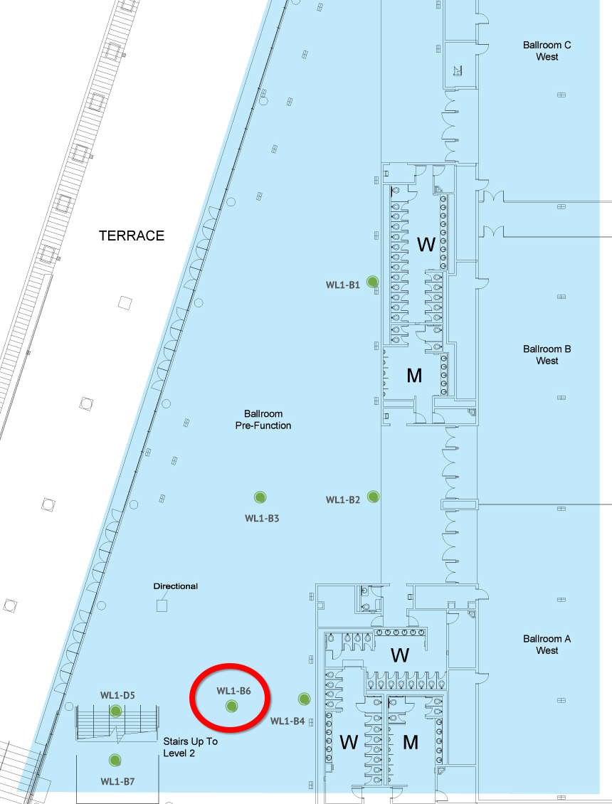
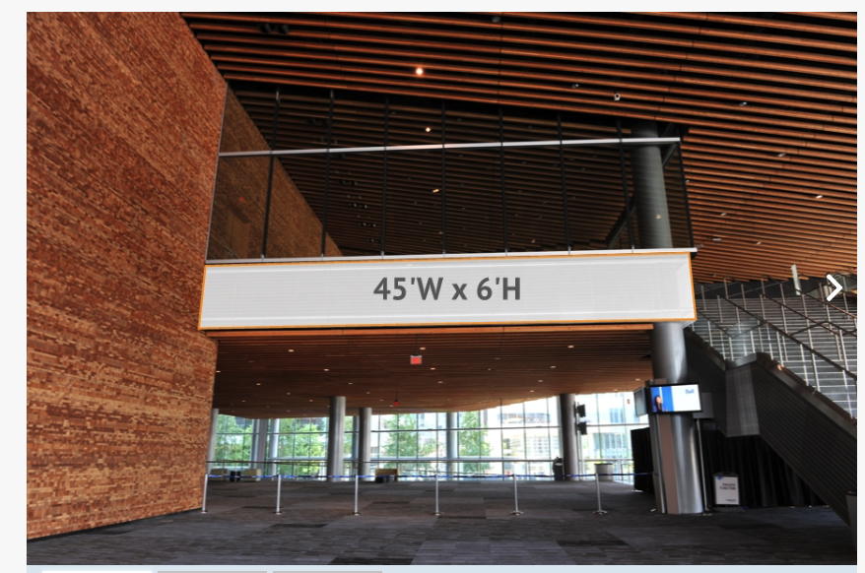
45’W X 6’H Single-Sided Banner WL1-B6 Main Foyer Near Ballroom– Level 1 $12,500
Exclusive Opportunity

Slide 6
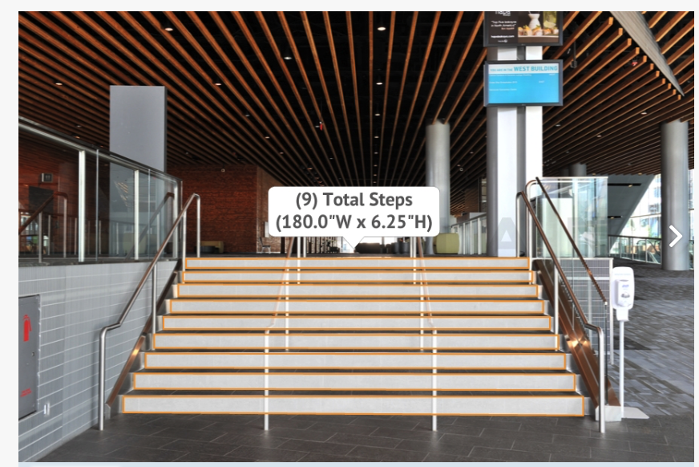
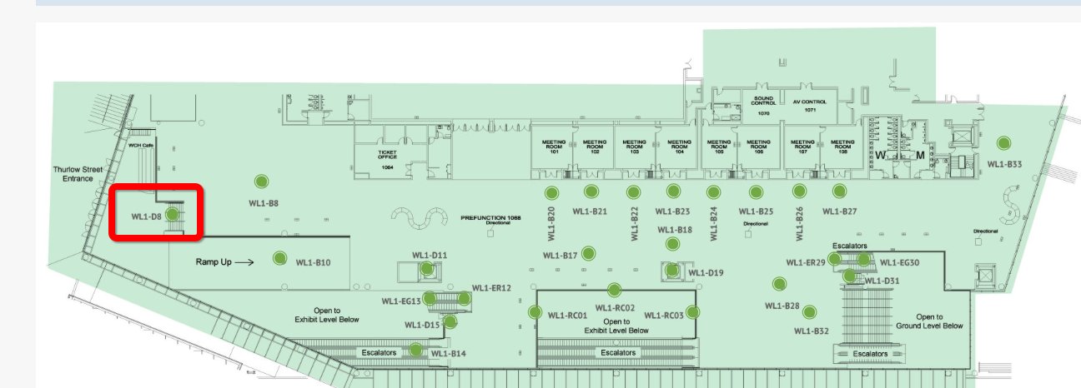
Stair Graphics – 9 Total Steps WL1-D9 Level 1 - Thurlow Entrance $6,000
Exclusive Opportunity

Slide 7
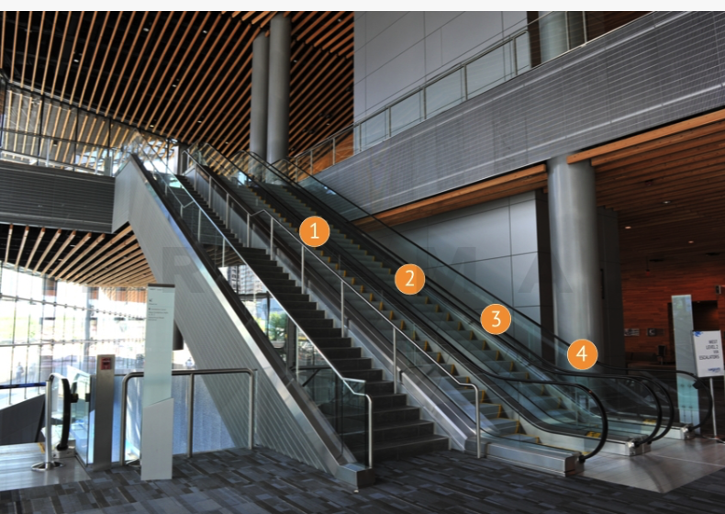
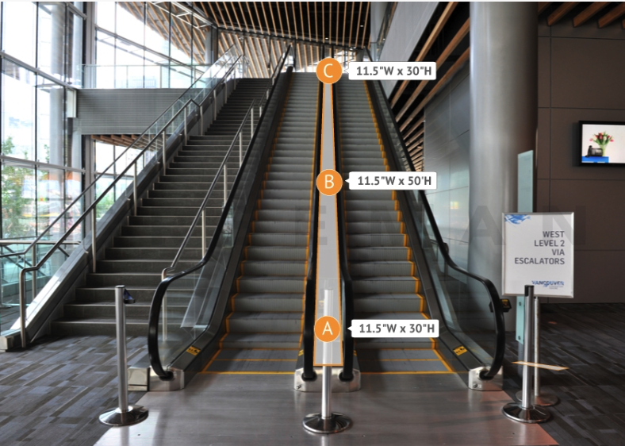
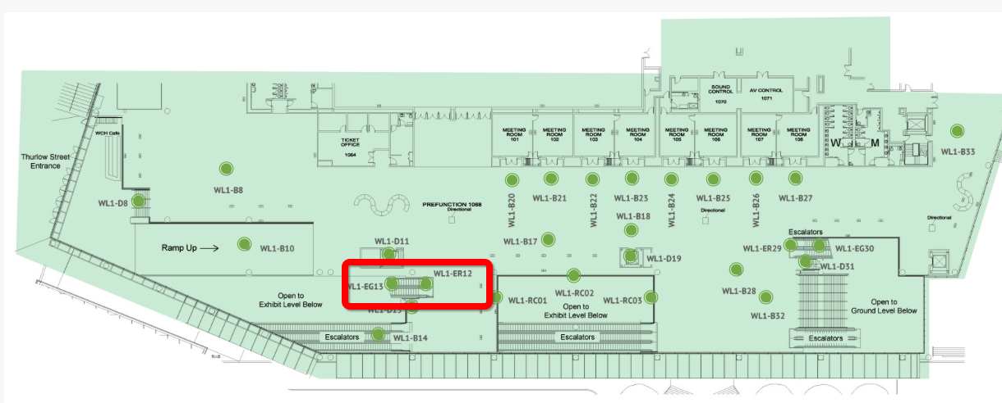
Escalator Runner and Escalator Clings
WL1-ER12 and WL1-EG13
Level 1 to Level 2 on West Side $25,000
Exclusive
Opportunity

Slide 8
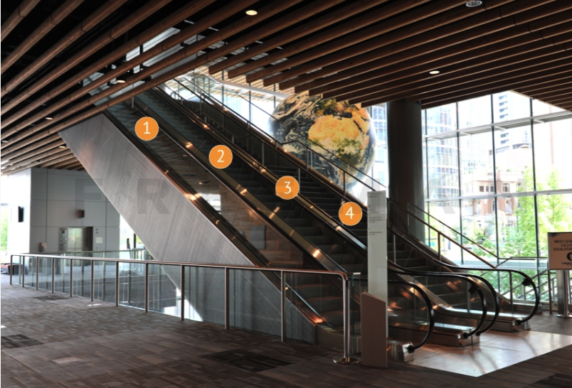
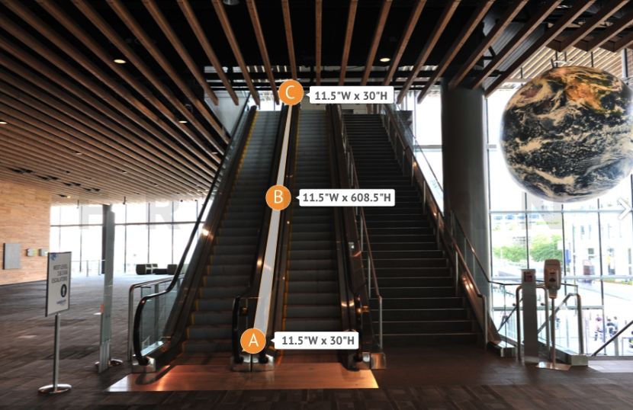
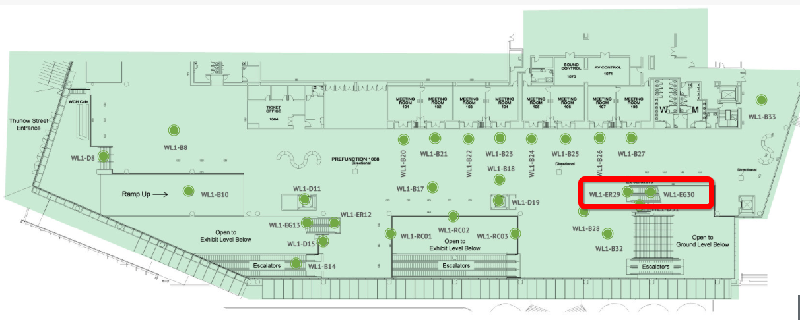
Escalator Runner and Escalator Clings
WL1-ER29 and WL1-EG30
Level 1 to Level 2 next to Globe $25,000
Exclusive
Opportunity

Slide 9
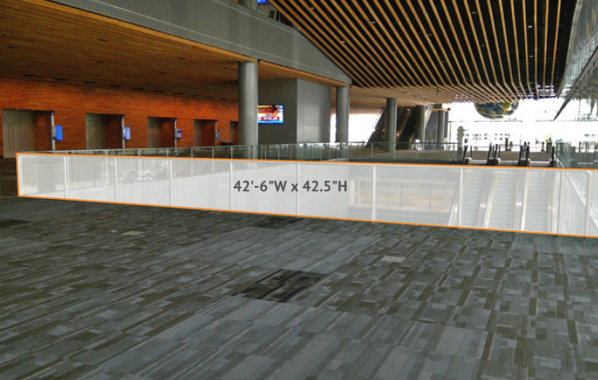
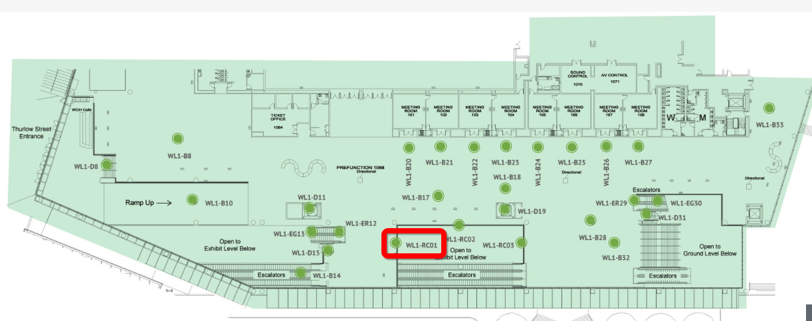
Single-Sided Glass Cling (dimensions to be provided)
WL1-RC01
Glass Rail Level 1 - West Side $12,500
Exclusive Opportunity

Slide 10
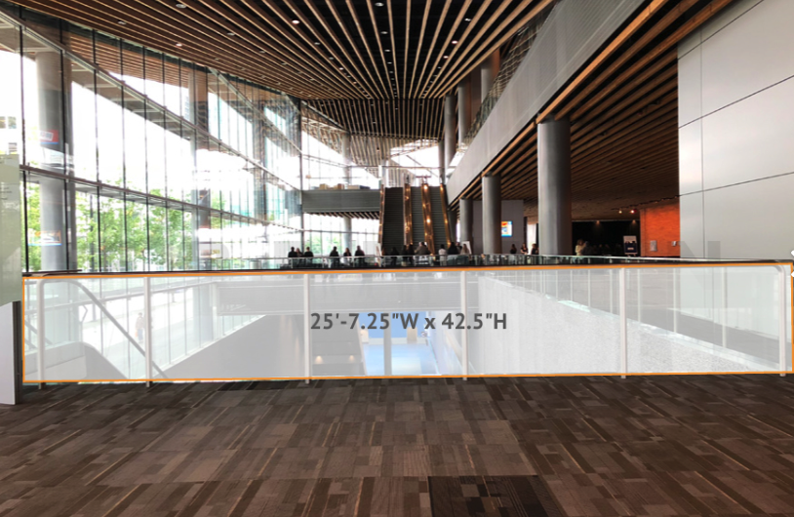
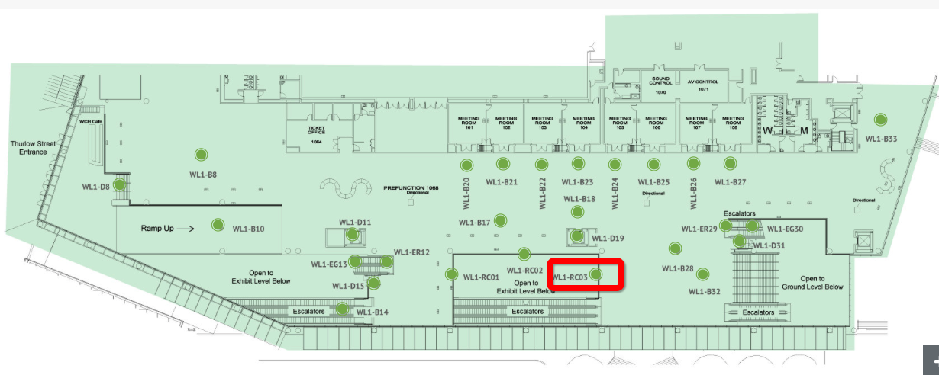
Single-Sided Glass Cling (dimensions to be provided)
WL1-RC03
Glass Rail Level 1 - Near Globe $12,500
Exclusive Opportunity

Slide 11
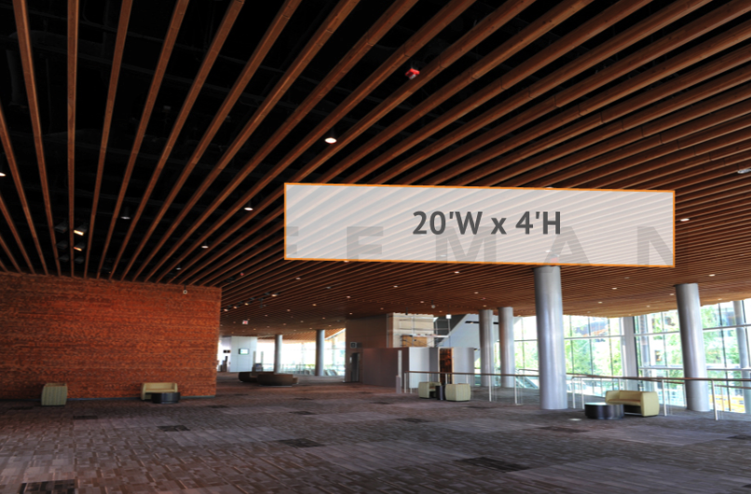
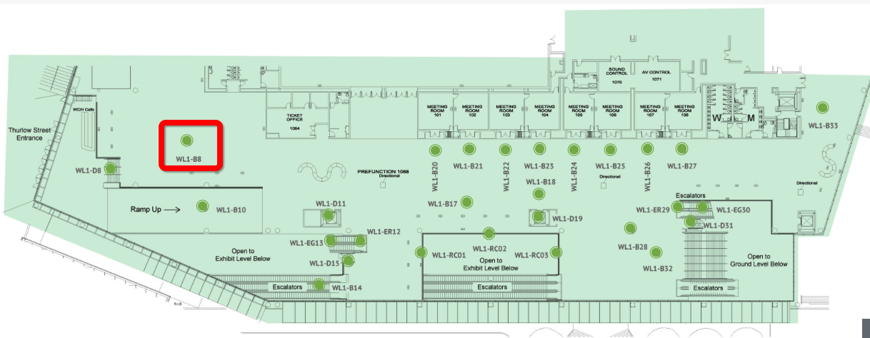
Double-Sided Banner 20’ W x 4’ H
WL1-B8
Main Foyer Thurlow Street $6,000
Exclusive Opportunity

Slide 12
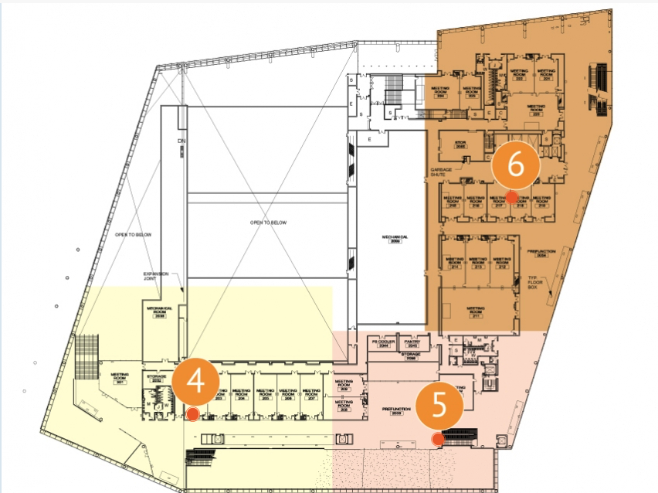
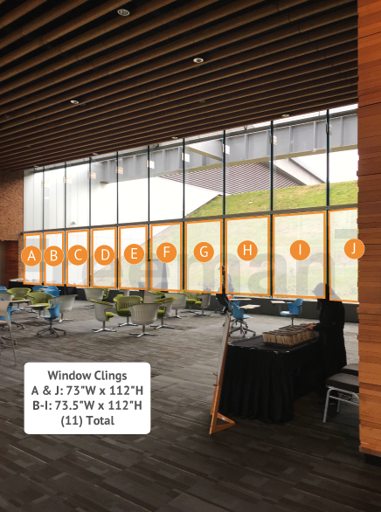
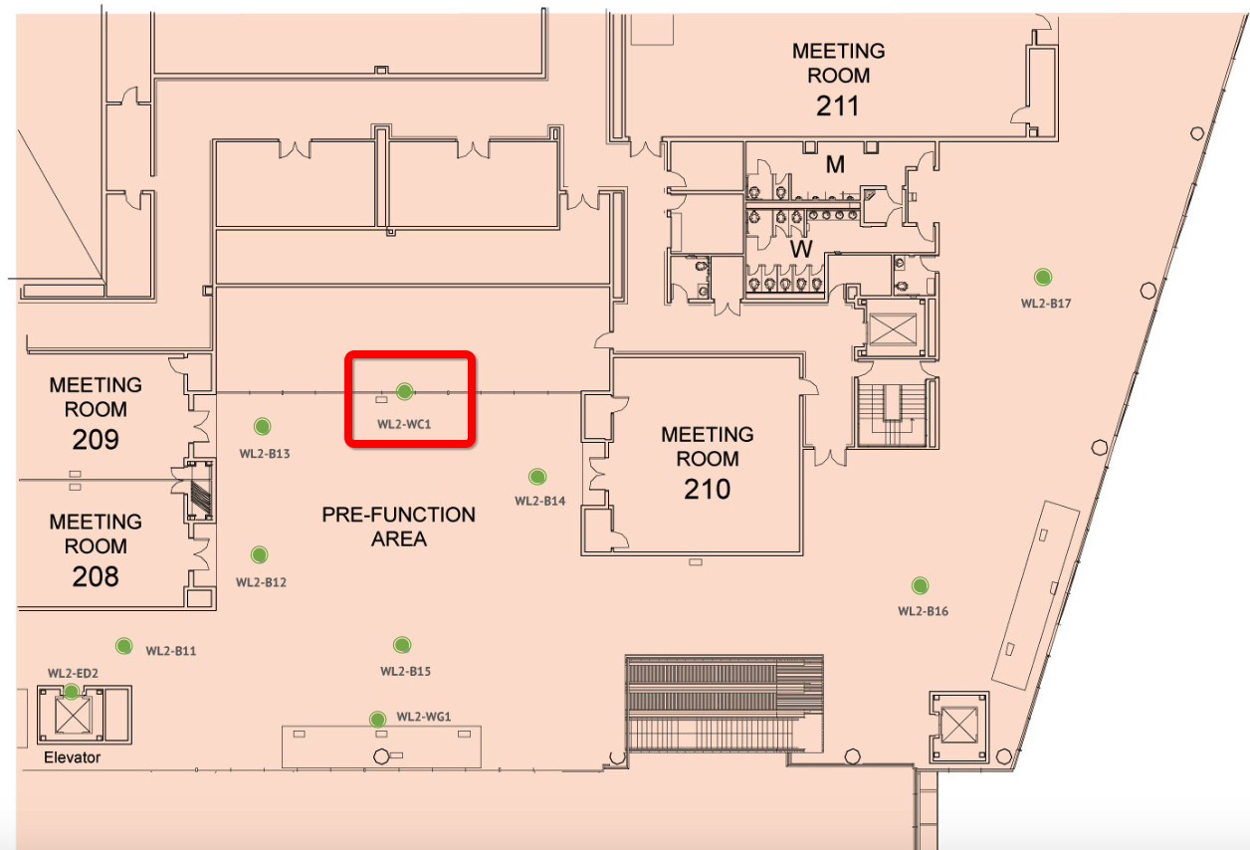
Window Clings
WL2-WC1
Level 2 Pre-Function area near 208-210 $30,000
Exclusive Opportunity
11 Total Clings

Slide 13
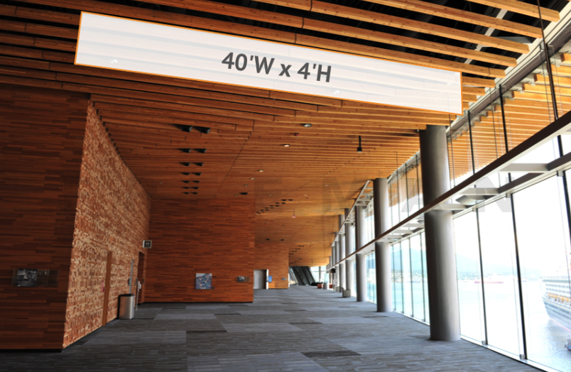
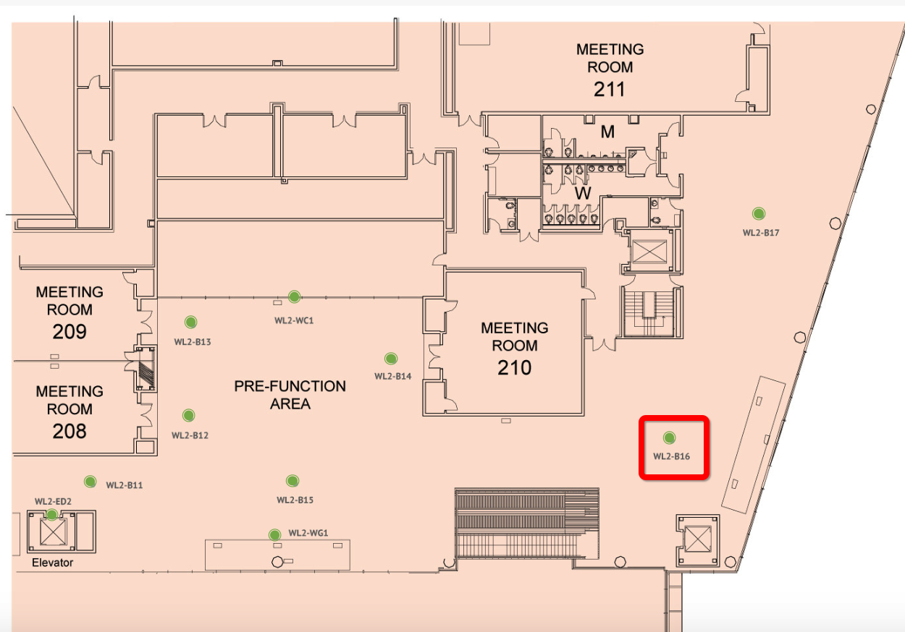
Double-Sided Banner
WL2-B16
Level 2 Behind Room 210 $6,000
Exclusive Opportunity

Slide 14
Digital Signage

Slide 15
DIGITAL SIGNAGE
Reach out to Nicole Horn or Anthony O’Shea if you are interested in learning more when the opportunities become available.
COMING SOON!

